Slide 1
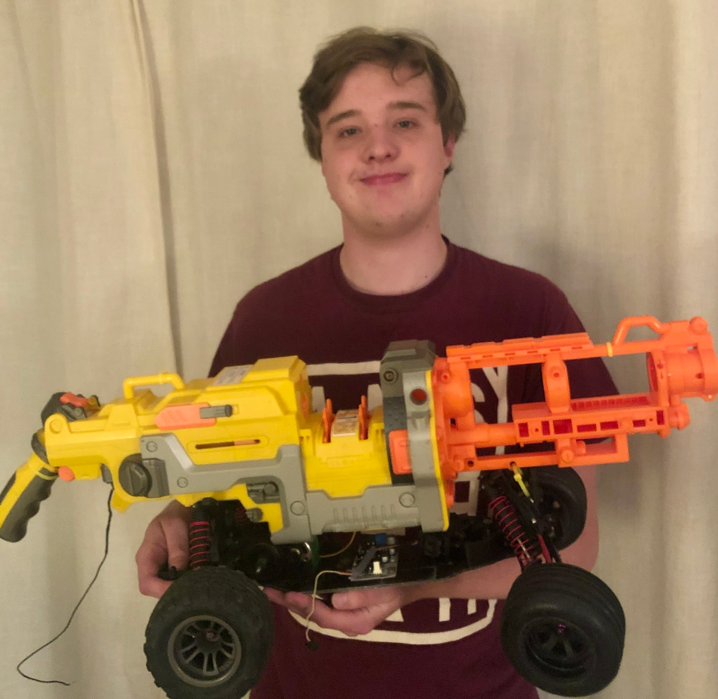

Slide 2
UVG By: Benoit Moreau
The goal of this project was to build an unmanned ground vehicle (UGV) with a turret that shoots foam darts This UGV can move forwards, backwards, left and right as well as shoot things. All of these actions can be controlled remotely by a user via a graphical user interface on a computer. Using this interface, the user can move the vehicle using the WASD keys and fire the gun using the left mouse button. The connection between the vehicle and the interface is done using WIFI.

